Slide 1
Restaurant Dataset Analysis
Prepared by Mohanad Alaa

Slide 2
Project Workflow 1.Understanding the Data Understand the dataset structure and business problem. 2.Data Exploration Explore data quality, distributions, and patterns. 3.Data Cleaning Prepare and transform the data for analysis. 4.Data Analysis Extract insights and visualize business performance

Slide 3
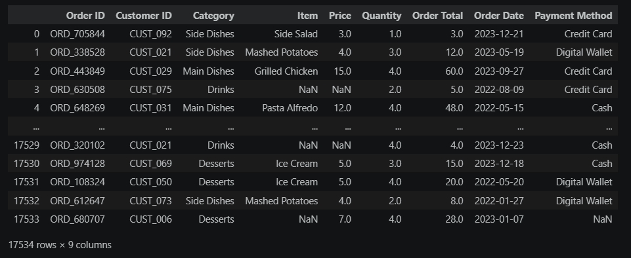
1.Understanding the dataset
Overview
The dataset contains sales transactions from a restaurant.
Each row represents a single customer order.
It includes information about customers, orders, menu items,
payment methods, and sales values.
The data is used to analyze restaurant performance,
customer behavior, and sales trends
Objective
Understand customer purchasing behavior, identify sales trends, evaluate menu performance,
and support business decision-making

Slide 4
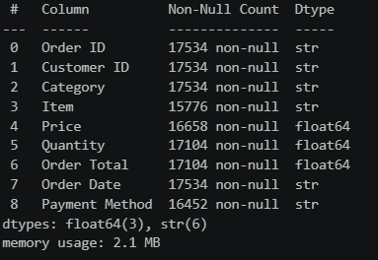
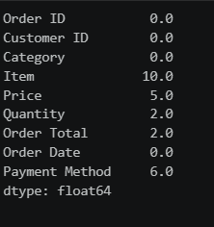
2.Data Exploration
A.Data info
1.Identified several missing (null) values across the dataset.
2.Detected that the Order Date column was stored
as String instead of DateTime.
B.Null values
1.Identified two columns with the same number of missing
values
2. Calculated the percentage of missing values for each
column
3. Evaluated the impact of missing data before the cleaning process

Slide 5
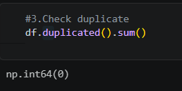
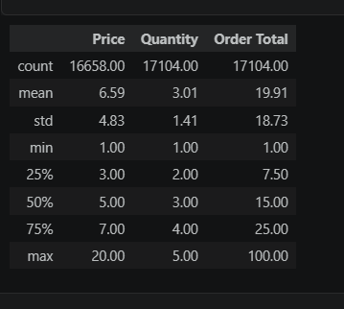
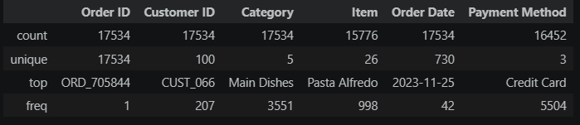
C. Check duplicates
There are no duplicates
D. Check description
It provides summary statistics that can be used to detect outliers
D. Check description for caterigal columns

Slide 6
3.Data Cleaning
1.Filled missing values in Payment Method with "Unknown"
2.Renamed Order Total to Total Price
3. Changing data type of Order Date column.
4.Calculated missing Price values using Price = Total Price\Quantity
5. Removed the remaining rows containing missing values.

Slide 7
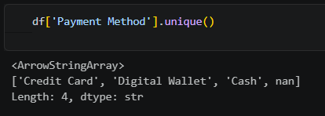
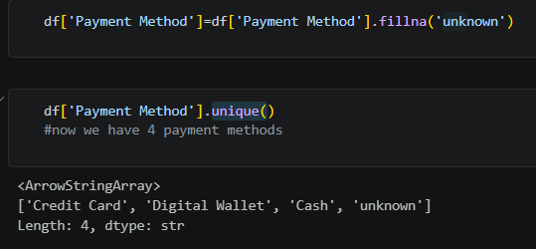


1.Filled missing values in Payment Method with "Unknown"
2.Renamed Order Total to Total Price

Slide 8

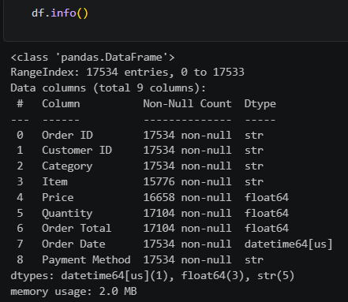
3. Changing data type of Order Date column.

Slide 9
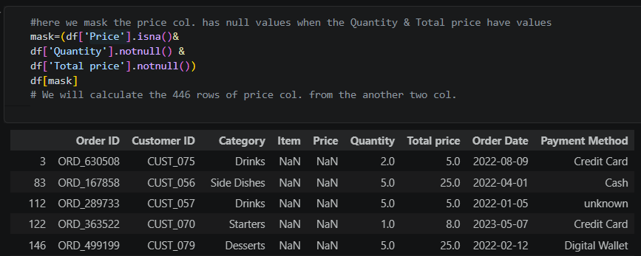
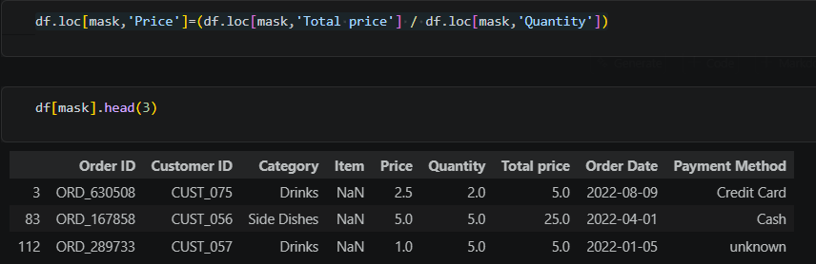
4.Calculated missing Price values using Price = Total Price\Quantity

Slide 10
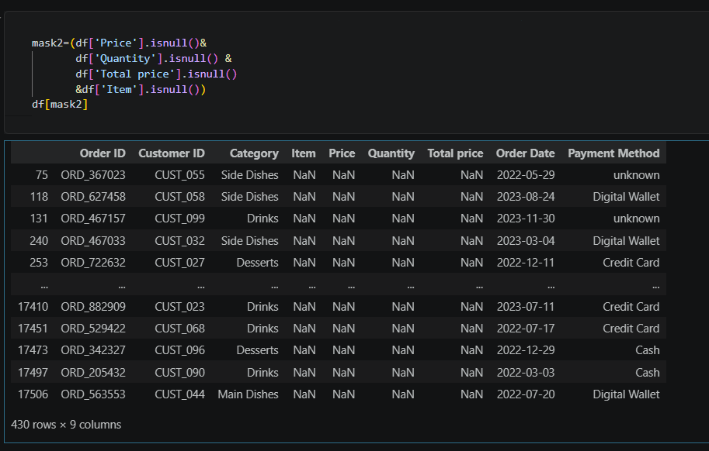
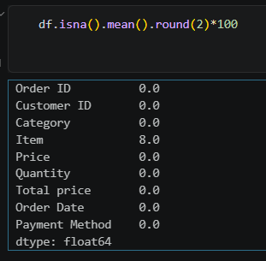

5. Removed the remaining rows containing missing values.

Slide 11
4.Data Analysis
Let's move to the interactive dashboard and start exploring the data to uncover valuable insights.

